Slide 1

Connecting non-data Literate Stakeholders to Data using R and Shiny
A case study using Cardiovascular Disease
By Cathrine Lind

Slide 2
Raw data
Collected from 3 databases and Kaggle:
Hungarian Institute of Cardiology, Budapest
V.A. Medical Center, Long Beach, CA
University Hospital, Zurich, Switzerland
Cardiovascular Disease dataset
Notes:
Tidy principles: Each variable forms a column.
Each observation forms a row.
Each type of observational unit forms a tab

Slide 3

Hungarian, Long Beach and Switzerland
.txt files with line breaks and no header
Contains 76 variables -> reduced to 9
All converted to numeric
Added 3 variables being factor versions of the columns: sex, fbs and cp
Notes:
OBS: These 3 are cleaned the exact same way
NA values are represented by ‘-9’

Slide 4
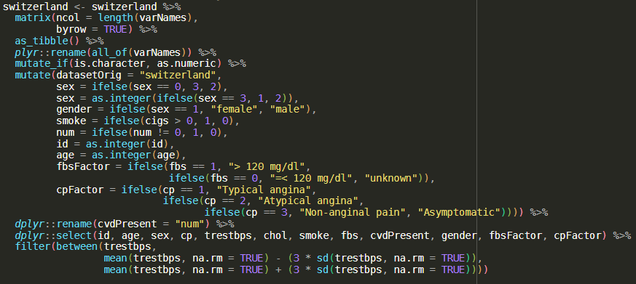

Slide 5
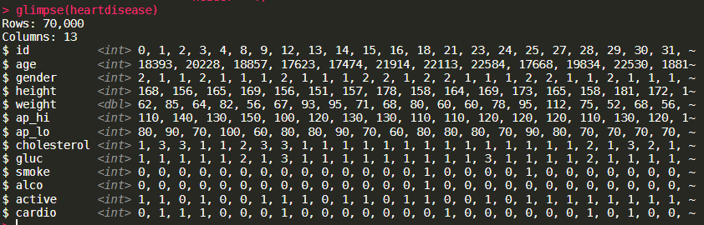
Cardiovascular Disease dataset
Contained 13 variables, where as 9 is kept and 5 is added: fbsFactor, cpFactor, sex, bmi and ap_mean
More clean than the other data sets
Notes:
In generel the work load here has been on trying to match the columns across the datasets with each other in order to combine them later.

Slide 6
The Shiny application

Slide 7
The Shiny application
Followed Mastering Shiny book
Created a shiny with top level navigation bar to toggle 4 different taps:
Data information
About cardiovascular disease (CVD)
The data
Pre-processing
Data
Visualization
Models

Slide 8
Styling of the Shiny
Used the library fresh for creating custom Bootstrap theme
Main colors used:

Slide 9
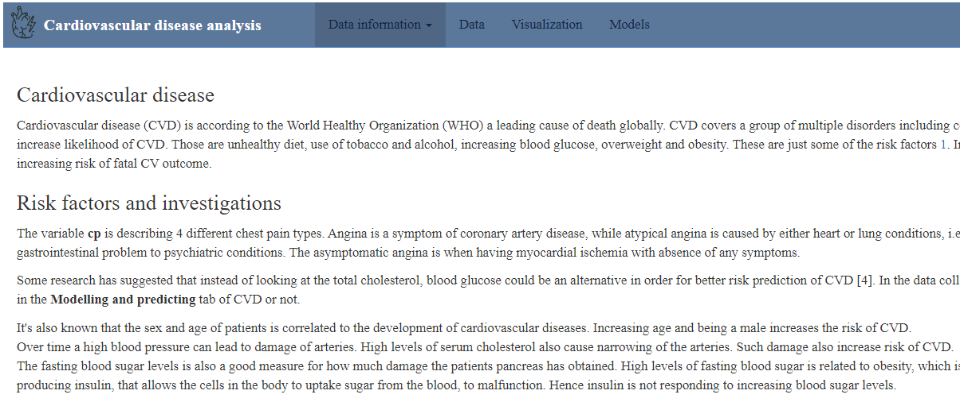
Data information
About CVD

Slide 10
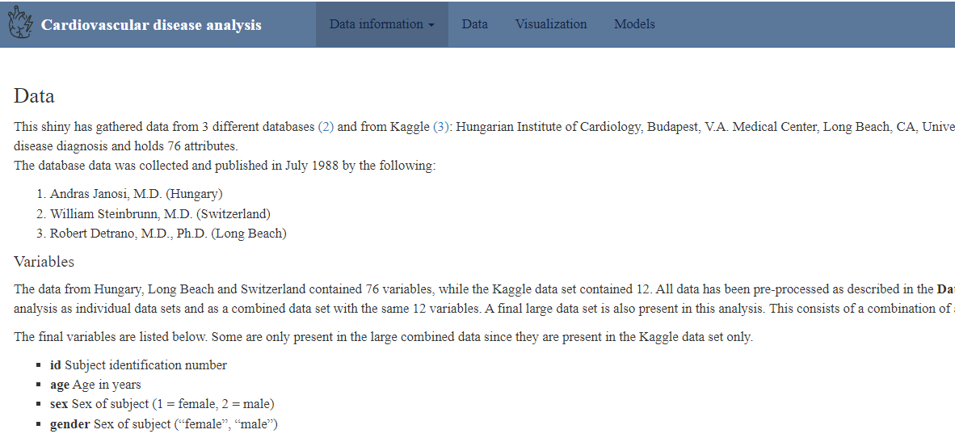
Data information
The data

Slide 11
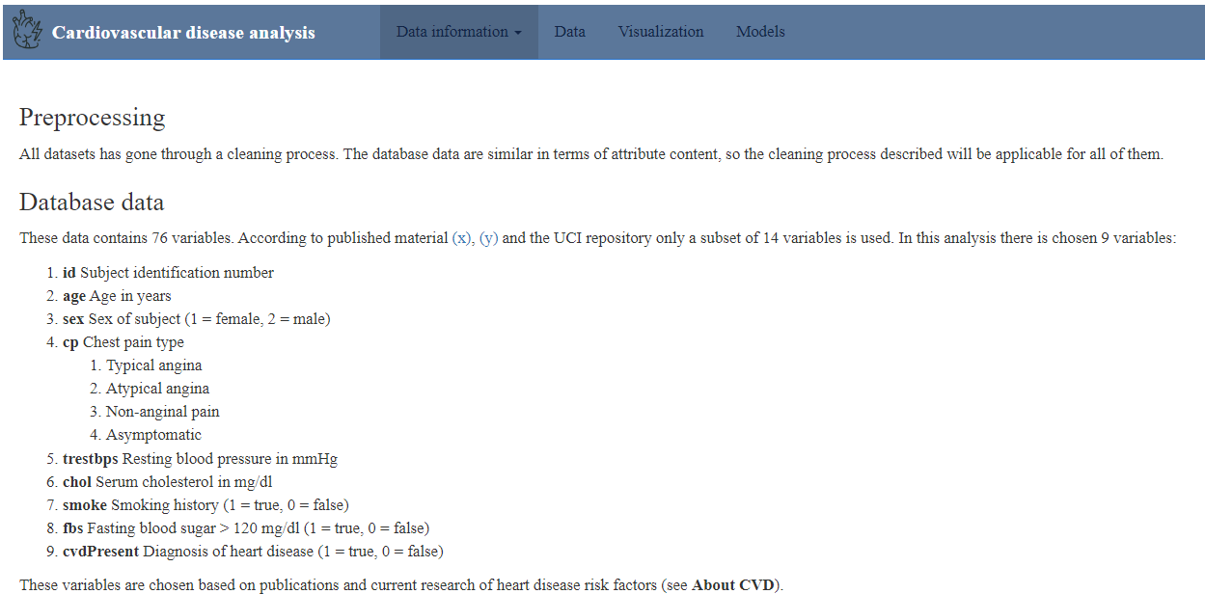
Data information
Pre-processing

Slide 12
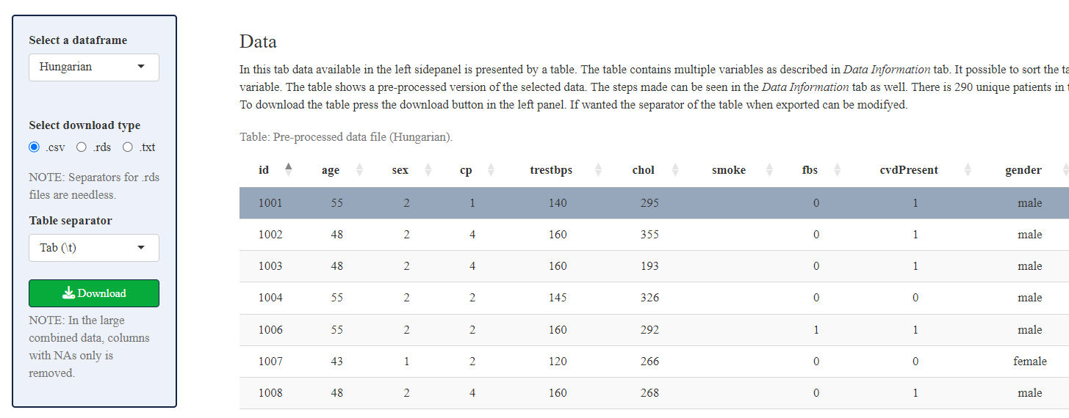
Data tab

Slide 13
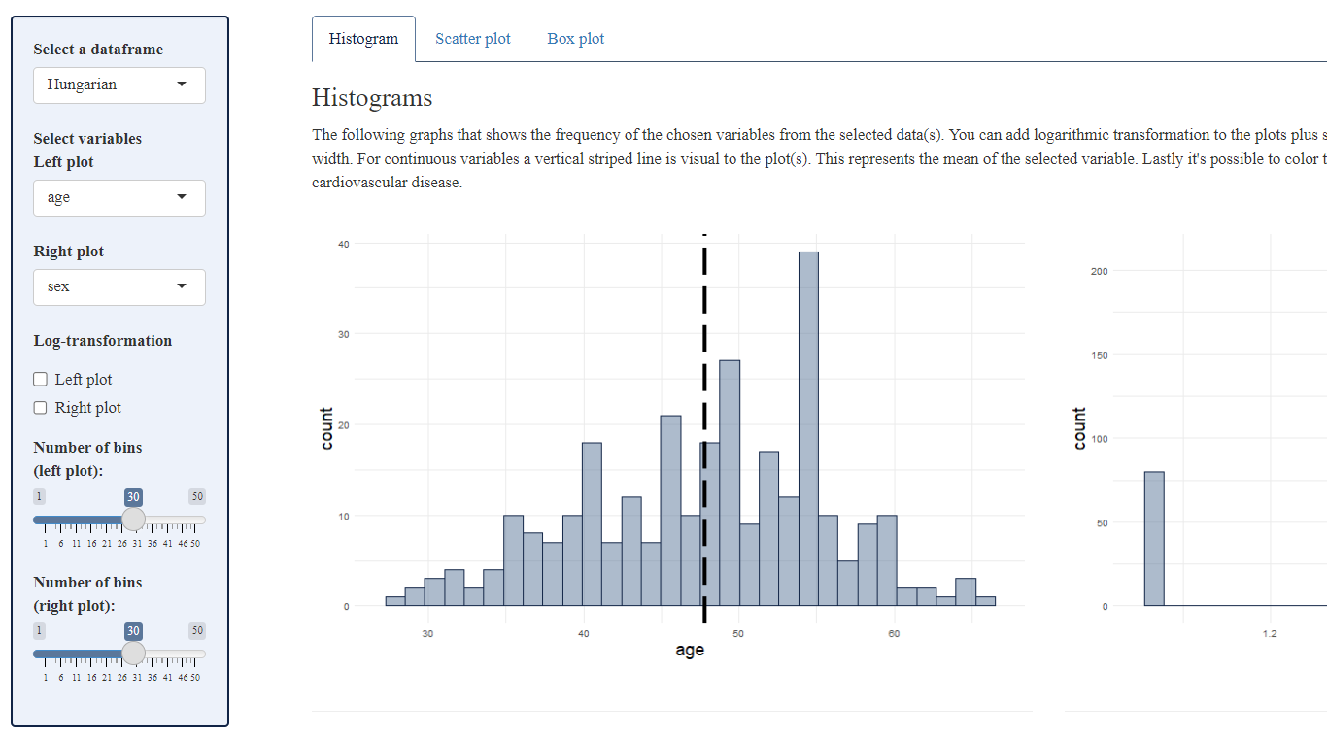
Visualization tab

Slide 14
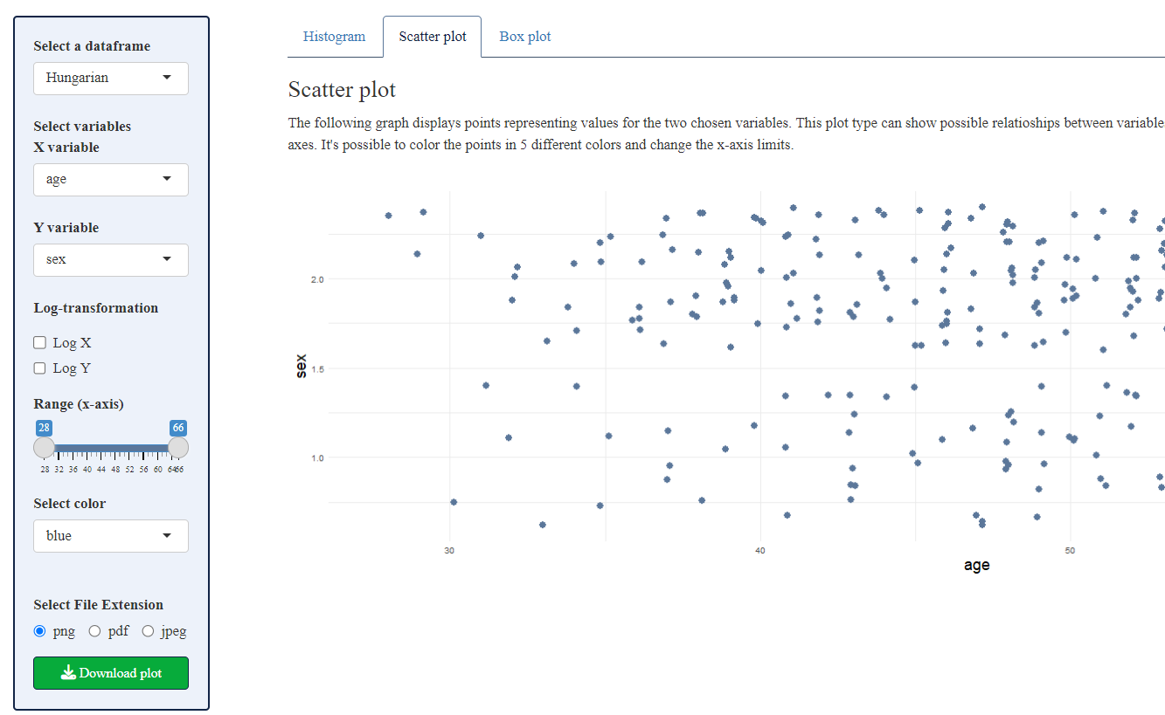
Visualization tab

Slide 15
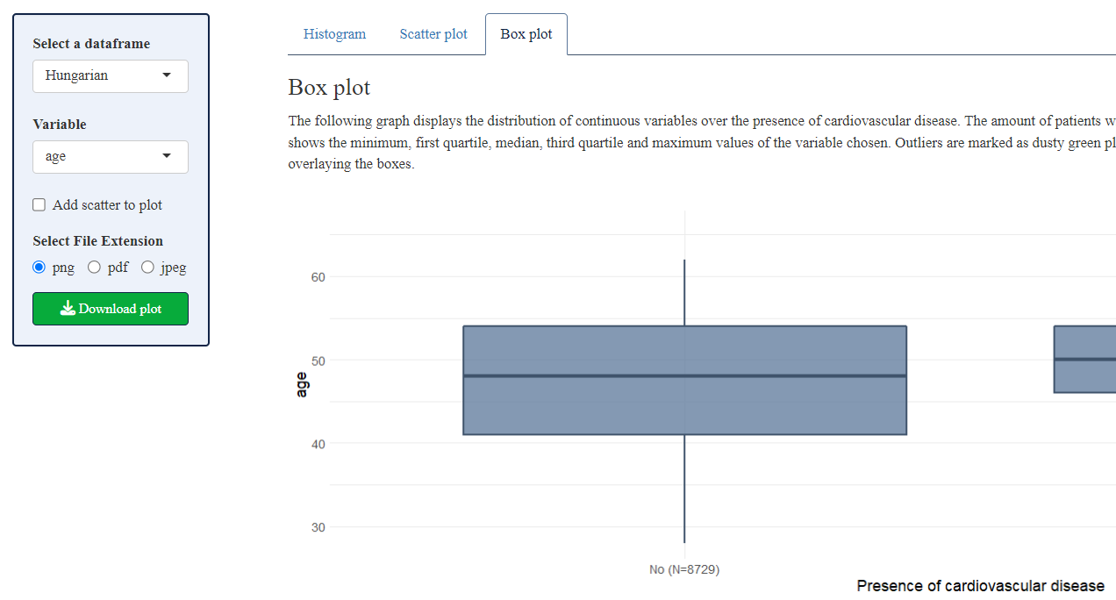
Visualization tab

Slide 16
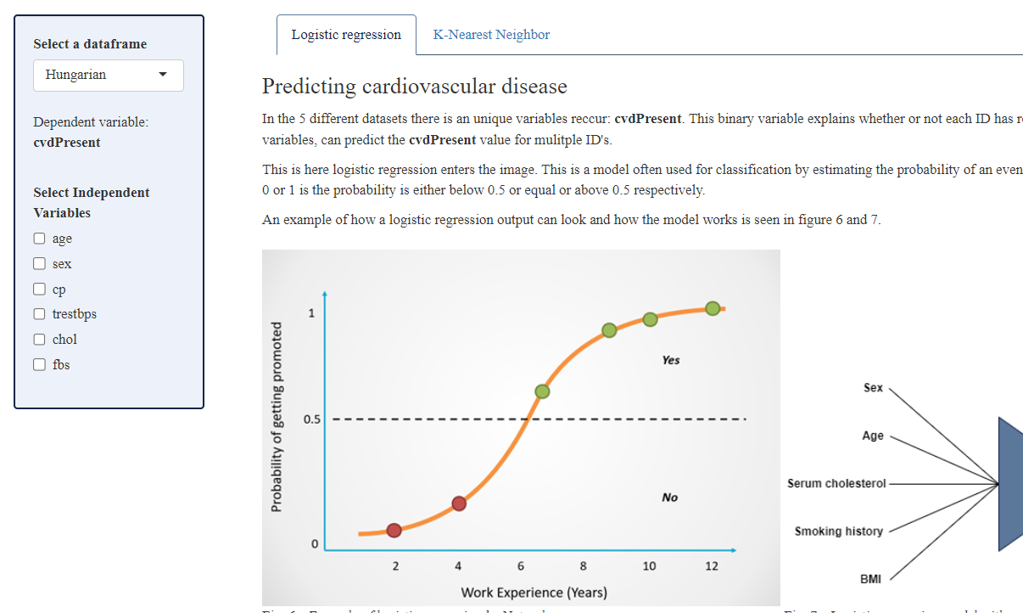
Models – logistic regression

Slide 17
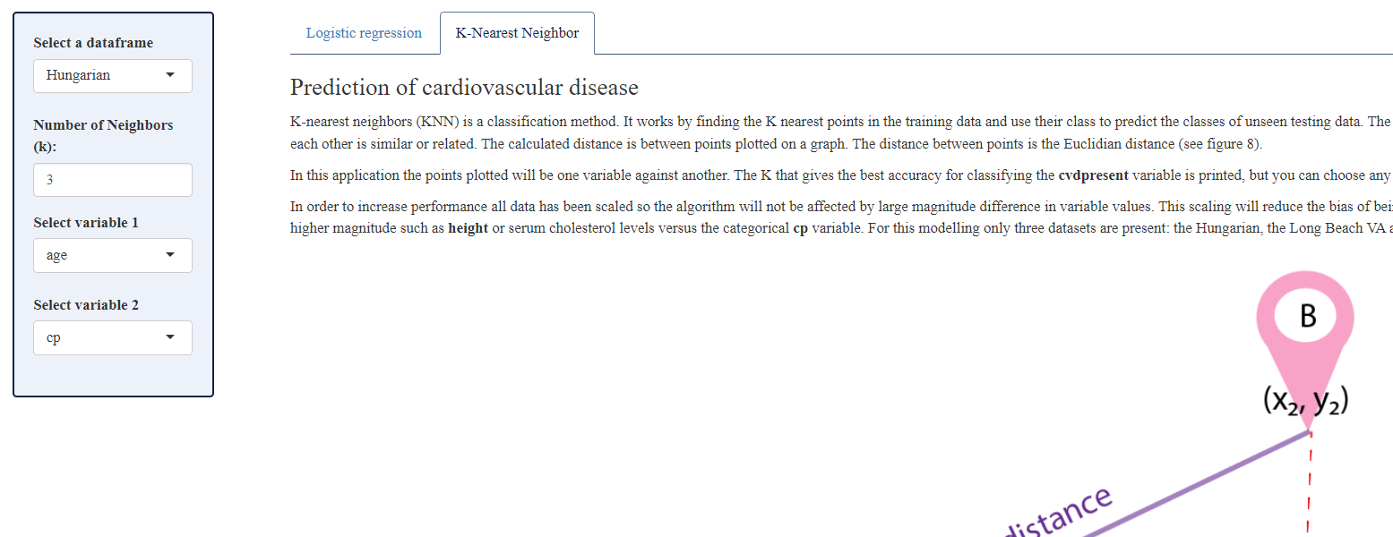
Models – K-Nearest Neighbors

